Slide 1


Unit 2
Preparing for training sessions
Notes:
Welcome to Unit 2 of Module 7.

Slide 2

By the end of this unit, you will be able to:
explain how to prepare for training sessions that you will facilitate
Notes:
By the end of this unit, you will be able to explain how to prepare for training sessions that you will facilitate.

Slide 3


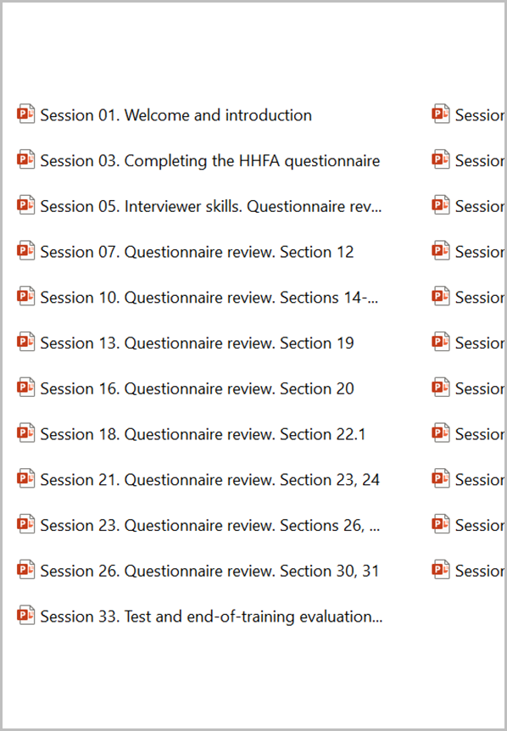

How to prepare for sessions you need to facilitate
HHFA questionnaire
Facilitator’s guide
Sessions
Reference manual
Notes:
To prepare for a Data Collection training session, you will need to use some of the HHFA tools that we discussed in Unit 1.

Slide 4
How to prepare for sessions you need to facilitate
The HHFA questionnaire and the Facilitator’s guide should always be open and accessible when facilitators start their preparation of the training.
Notes:
To start, the HHFA questionnaire and the Facilitator’s guide should always be open and accessible when facilitators start their preparation of the training.

Slide 5

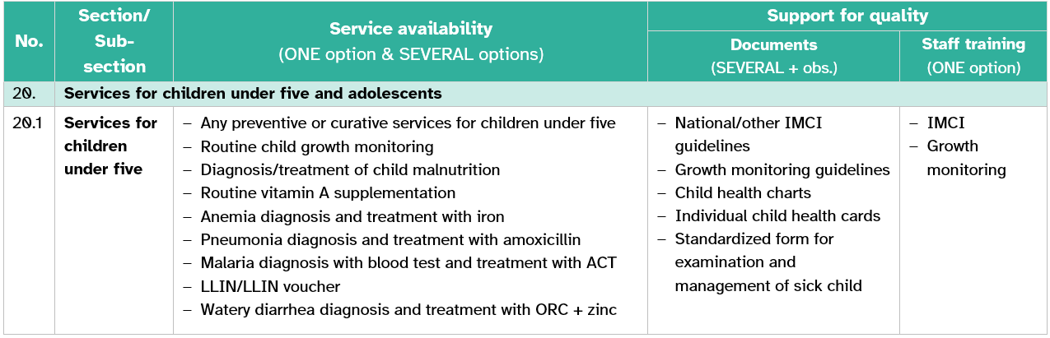
How to prepare for sessions you need to facilitate
If you have been assigned sessions from sections 13 to 31, the summary tables can help you to:
visualize
summarize
review technical content
Notes:
If you have been assigned sessions from questionnaire sections 13 to 31, the summary tables can help you to easily:
visualize;
summarize; and
review technical content.

Slide 6
How to prepare for sessions you need to facilitate
Facilitator’s guide
training purpose
audience
training package
purpose of/how to use the guide
schedule
learning outcomes
methods
approach
materials and equipment
Read and follow the introduction chapter.
human resources
Notes:
From the Facilitator’s guide, read and follow the introduction chapter, which covers general topics such as:
training purpose;
audience;
training package;
purpose of and how to use the guide;
schedule;
learning outcomes;
methods;
approach;
materials and equipment; and
human resources.

Slide 7

How to prepare for sessions you need to facilitate
Review specific guidance (Facilitator’s guide)
Review guidance jointly with PowerPoint sessions
approximate duration of the session
learning outcomes
content
materials needed
animation
learning outcomes
illustrations
materials to be reviewed when preparing for the session
images
key points to consider during the session
learning activities
Notes:
Next, review the specific guidance for the sessions you have been assigned to facilitate from the Facilitator’s guide. This will contain:
approximate duration of the session;
materials needed;
learning outcomes;
materials to be reviewed when preparing for the session; and
key points to consider during the session.
This guidance should be reviewed jointly with the PowerPoint sessions you have been assigned to facilitate, which contain:
learning outcomes;
content, supported with:
animation;
illustrations;
images; and
different active learning activities.

Slide 8
How to prepare for sessions you need to facilitate
HHFA questionnaire
Facilitator’s guide
Sessions
Reference manual
In case of doubts on any question or session, consult the reference manual for support.
Notes:
In the case of doubts on any particular question or session, consult the Reference manual for support.

Slide 9
You have now completed Unit 2.
Now review these steps in the practice exercise, then try the module quiz.
Notes:
You have now completed Unit 2.
Now review these steps in the practice exercise, then try the module quiz.

